Slide 1


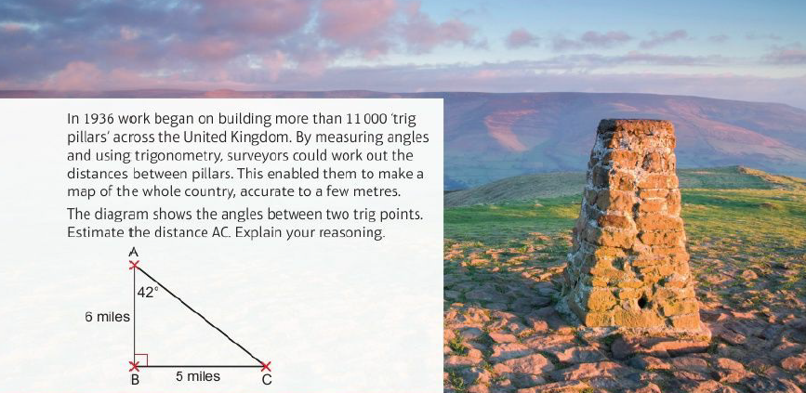
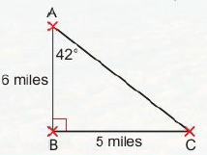
Mathematics (9-1) - iGCSE
2018-20
Year 09
In 1936 work began on building more than 11000 'trig pillars' across the United Kingdom. By measuring angles and using trigonometry, surveyors could work out the distances between pillars. This enabled them to make a map of the whole country, accurate to a few metres.
The diagram shows the angles between two trig points. Estimate the distance AC. Explain your reasoning.
Unit 5 – Angles and Trigonometry

Slide 2
Contents
Page iv
5 Angles and trigonometry 121
Prior knowledge check 121
5.1 Angle properties of triangles and quadrilaterals 122
5.2 Interior angles of a polygon 126
5.3 Exterior angles of a polygon 128
5.4 Pythagoras' theorem 1 131
5.5 Pythagoras' theorem 2 134
5.6 Trigonometry 1 136
5.7 Trigonometry 2 139
Problem-solving 143
Check up 144
Strengthen 147
Extend 153
Knowledge check 155
Unit test 157

Slide 3
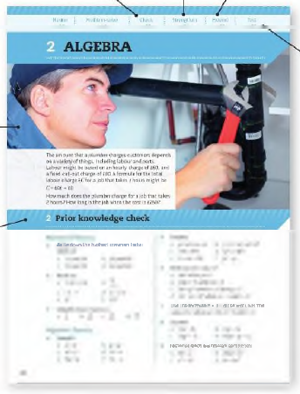
Contents
Page v
At the end of the Master lessons, take a check-up test to help you to decide whether to strengthen or Extend our learning
Extend helps you to apply the maths you know to some different situations
Unit Openers put the maths you are about to learn into a real-life context. Have a go at the question - it uses maths you have already learnt so you should be able to answer it at the start of the unit.
When you have finished the whole unit, a Unit test helps you see how much progress you are making.
Choose only the topics in strengthen thay you need a bit more practice with. You’ll find more hints here to lead you through specific questions. Then move on to Extend
Use the Prior knowledge check to make sure you are ready to start the main lessons in the unit. It checks your knowledge from Key Stage 3 and from earlier in the GCSE course. Your teacher has access to worksheets if you need to recap anything.

Slide 4
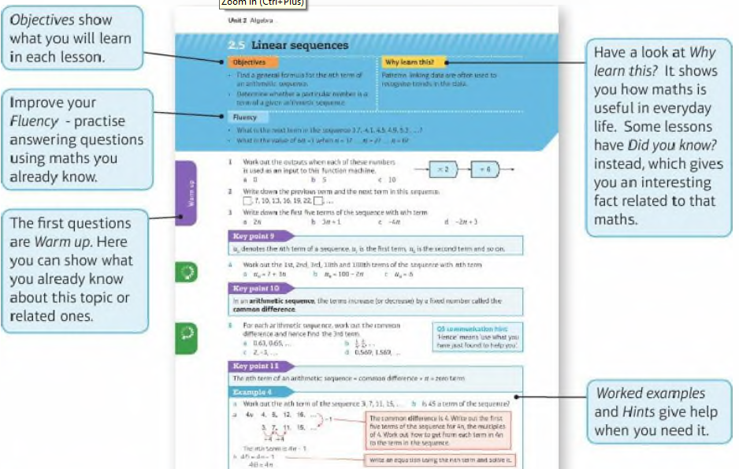
Contents
Page vi

Slide 5
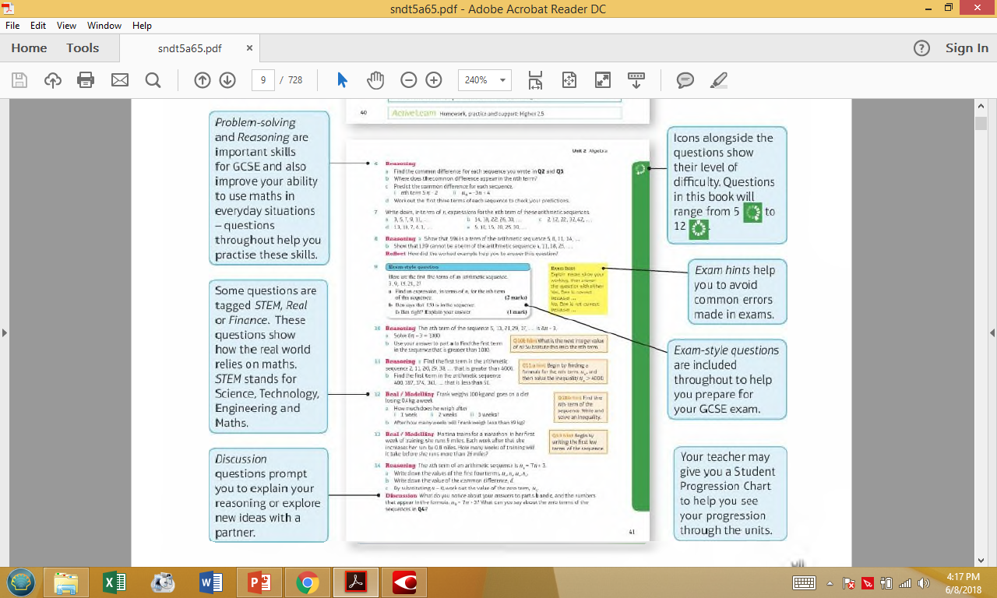
Contents
Page vi

Slide 6
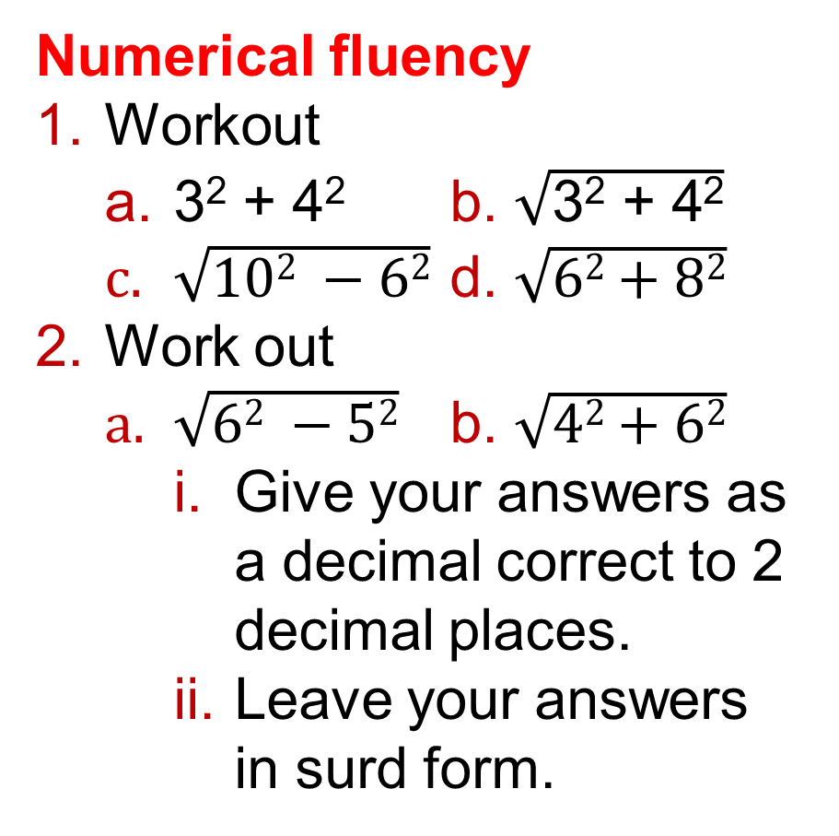
5 – Prior Knowledge Check
Page 121
Numerical fluency
Workout
  3² + 4² b. $\sqrt{\text{3}\text{2}\text{ + 4}\text{2}}$
  $\sqrt{102 −62}$ d. $\sqrt{62+82}$
Work out
  $\sqrt{62 −52}$ b. $\sqrt{42+62}$
    Give your answers as a decimal correct to 2 decimal places.
    Leave your answers in surd form.

Slide 7
5 – Prior Knowledge Check
Page 121
Geometrical fluency
List ALL the quadrilaterals which have
  exactly ONE pair of parallel sides
  four right angles
  two or more lines of symmetry
  no pairs of parallel sides e no right angles.
What is the name given to a regular
  triangle
  quadrilateral?

Slide 8

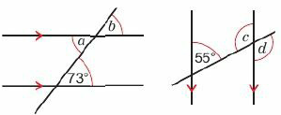
5 – Prior Knowledge Check
Page 121
Geometrical fluency
Which of these shapes are regular?
Find the size of the angles marked with letters.
Give reasons for your answers.

Slide 9
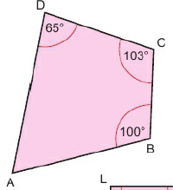
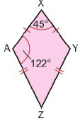
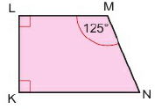
5 – Prior Knowledge Check
Page 121
a. Sketch an isosceles triangle PQR and draw on any lines of symmetry,
  Use your diagram to show that two angles are equal.
Work out the size of
  angle DAB b. Z.AZY
  MNK

Slide 10
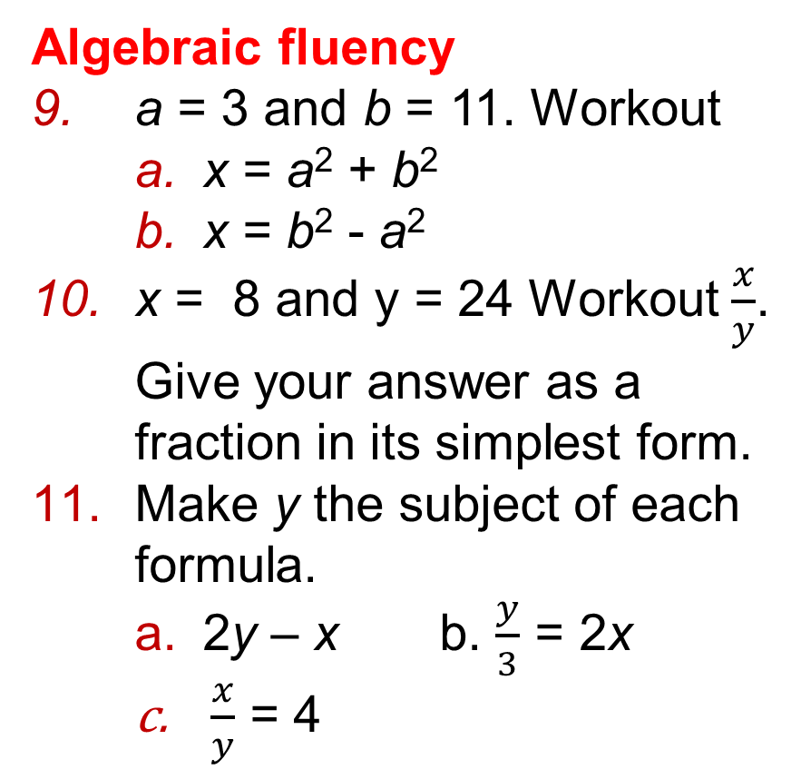
5 – Prior Knowledge Check
Page 122
Algebraic fluency
a = 3 and b = 11. Workout
    x = a² + b²
    x = b² - a²
x = 8 and y = 24 Workout $\frac{x}{y}$.
Give your answer as a fraction in its simplest form.
Make y the subject of each formula.
  2y – x b. $\frac{y}{3}$ = 2x
  $\frac{x}{y}$ = 4

Slide 11
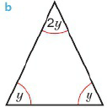
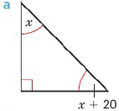

5 – Prior Knowledge Check
Page 122
Algebraic fluency
Write and solve an equation to calculate the size of each angle in degrees.
* Challenge
In an isosceles triangle, one angle is twice the size of one of the other angles. Work out the value of each angle.

Slide 12

5.1 Angle properties of triangles and quadrilaterals
Page 122
Objectives |  | Did you know
Derive and use the sum of angles in a triangle and in a quadrilateral. Derive and use the fact that the exterior angle of a triangle is equal to the sum of the two opposite interior angles. |  | The angle at which you hit a tennis ball affects its trajectory.
Fluency
Name these shapes
ActiveLearn - Homework, practice and support: Higher 5.1

Slide 13
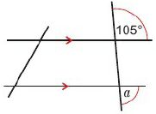
5.1 Angle properties of triangles and quadrilaterals
Page 122
What is the size of any angle in an equilateral triangle?
An isosceles triangle has one angle of 130°.
What are the sizes of the other two angles?
Work out the size of angle a. Give reasons for your answer.
Warm Up

Slide 14

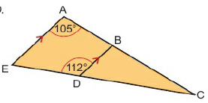
5.1 Angle properties of triangles and quadrilaterals
Page 123
ABC and CDE are straight lines. AE is parallel to BD. Work out the size of
  ABD b. BDC
  AEC d. ACE

Slide 15
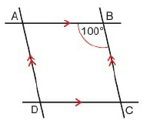
5.1 Angle properties of triangles and quadrilaterals
Page 123
Reasoning ABCD is a parallelogram.
  Copy the parallelogram and extend each side.
  Work out the other angles in the parallelogram.
  What do you notice about the opposite angles?
  Repeat with different parallelograms.
  Is your observation in part c still true?
  Reflect What property of parallelograms
  have you
  shown?
Q3 hint - Line BA is parallel to CD. Line CB is parallel to DA.

Slide 16
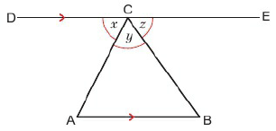
5.1 Angle properties of triangles and quadrilaterals
Page 123
Triangle ABC is shown. DE is parallel to AB.
  What is the value of x + y + z? Give a reason for your answer,
  Copy the diagram. Mark on the size of each of these angles in terms of x, y and z.
    angle CAB ii. angle ABC
  Give reasons for your answers.
  Use your answer to part a to derive the sum of angles in a triangle.
Q6c hint – x + y + z = _________⁰
The angle sum of a triangle is ________⁰

Slide 17
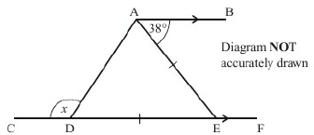
5.1 Angle properties of triangles and quadrilaterals
Page 123
7 – Exam-Style Questions
CDEF is a straight line. AB is parallel to CF. DE = AE. Calculate the size of the angle marked x. You must give reasons for your answer. (4 marks)
Exam hint
Mark on the diagram the size of any angles that you know.
Start by using the rules of parallel lines to find another angle on the diagram. Then find which two angles are equal in the isosceles triangle by looking to see which two sides are equal.

Slide 18
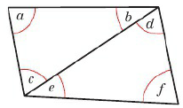
5.1 Angle properties of triangles and quadrilaterals
Page 124
Communication / Reasoning
In this diagram a diagonal divides the quadrilateral into two triangles.
Use the diagram to prove that the angle sum of a quadrilateral is 360°.
Q8 hint – Begin a + b + c = _______⁰

Slide 19
5.1 Angle properties of triangles and quadrilaterals
Page 124
Key Point 1
When one side of a triangle is extended at the vertex:
the angle marked x is called the interior angle.
the angle marked y is called the exterior angle.
x + y = 180° (angles on a straight line)

Slide 20
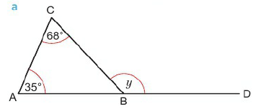
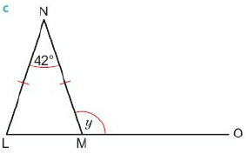
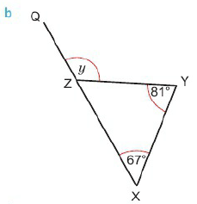
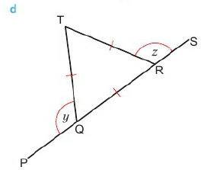
5.1 Angle properties of triangles and quadrilaterals
Page 124
Work out the size of each angle marked with a letter.
Discussion What do you notice about the relationship between the exterior angle of a triangle and the interior angles at the other two vertices?

Slide 21
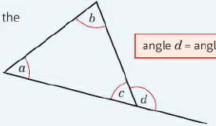
5.1 Angle properties of triangles and quadrilaterals
Page 124
Key Point 2
The exterior angle of a triangle is equal to the sum of the interior angles at the other two vertices.
Angle d =
angle a + angle b

Slide 22
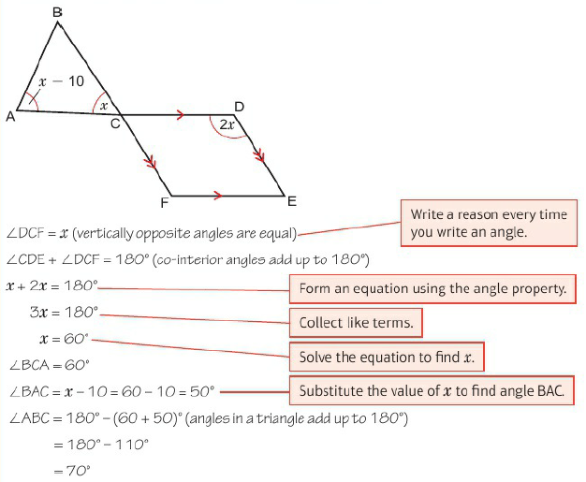
4.2 - Ratios
Page 125
Example 1
Work out the size
of angle ABC.
Give reasons for
your answer

Slide 23
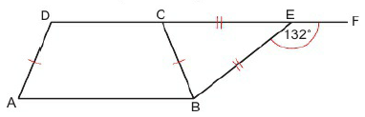
5.1 Angle properties of triangles and quadrilaterals
Page 124
ABCD is an isosceles trapezium. BCE is an isosceles triangle. DCEF is a straight line.
Angle BEF = 132°.
Work out the size of angle DAB. Give reasons for your working.
Q10 hint – Start with:
angle BCE + angle CBE =___⁰
(exterior angle is equal to the sum of the __)
angle BCE = angle CBE ( _____ )
Write any angles you work out on a sketch of the diagram.
Q10 communication hint - To 'give reasons for your working' write the angle property you use for every angle you find.

Slide 24
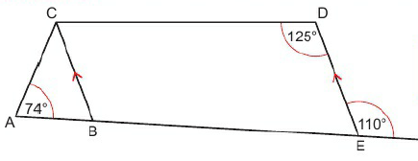
5.1 Angle properties of triangles and quadrilaterals
Page 124
Reasoning Work out the size of angle ACB. Give reasons for your working.
Q11 hint – Use the properties on the diagram:
BC is parallel to DE

Slide 25
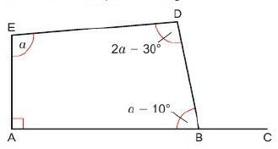
5.1 - Angle properties of triangles and quadrilaterals
Page 126
Work out the size of angle CBD. Give reasons for your working.
Q12 hint – Use the fact that angles in a quadrilateral add up to 360⁰ to write an equation.

Slide 26
5.2 – Interior Angles of a Polygon
Page 126
Objectives |  | Why learn this?
Calculate the sum of the interior angles of a polygon. Use the interior angles of polygons to solve problems. |  | Polygons are used in the construction of buildings and bridges due to their strength and beauty.
Fluency
Name these polygons What can you say about the sides and angles in a regular polygon?
ActiveLearn - Homework, practice and support: Higher 5.2

Slide 27
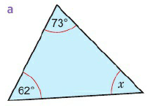
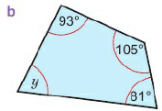
5.2 – Interior Angles of a Polygon
Page 126
For each value of n,
work out (n - 2) x 180
    n = 3 b. n = 5
    n = 7 d. n = 8
Work out the size of each angle marked with a letter.
Warm Up

Slide 28
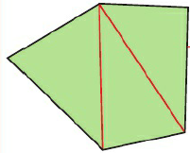
5.2 – Interior Angles of a Polygon
Page 126
Example 2
Workout the sum of the interior angles of a pentagon.
Sum of the interior angles of a pentagon = 3 x 180⁰ = 540⁰
A pentagon has five sides. Sketch a pentagon.
Draw in the diagonals from one vertex to all the other vertices.
The pentagon has been divided into 3 triangles. The angle sum if each triangle is 180⁰.

Slide 29
5.2 – Interior Angles of a Polygon
Page 127
Work out the sum of the interior angles of a
hexagon.
Discussion Does it matter if
the hexagon is regular or irregular?
Reasoning Copy and complete the table.
Discussion What do you think the sum of the angles in a 12-sided polygon (dodecagon) is?
Q3 hint - Use the same method as Example 2.
Polygon | Number of sides (n) | Number of triangles formed | Sum of interior angles.
Triangle | 3 | 1 | 180⁰
Quadrilateral | 4
Pentagon | 5 | 3 | 540⁰
Hexagon | 6
Heptagon | 7

Slide 30
5.2 – Interior Angles of a Polygon
Page 127
Key Point 3
The sum of the interior angles of a polygon with n sides = (n - 2) x 180°
A regular polygon has 20 sides.
  Work out the sum of the interior angles of the polygon.
  Work out the size of the interior angle.
Q5a hint – Substitute into
(n - 2) x 180°.

Slide 31

5.2 – Interior Angles of a Polygon
Page 127
Reasoning Work out the size of each interior angle of
  a regular pentagon
  a regular octagon
  a regular heptagon
  a regular polygon with 15 sides.
The sum of the interior angles of a polygon is 3060°.
How many sides does the polygon have?

Slide 32
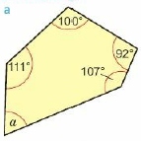
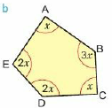
5.2 – Interior Angles of a Polygon
Page 127
Reasoning Workout the size of each unknown interior angle.
Q7a hint – First work out the sum of the interior angles for a 5-sided polygon.
Q7b hint – To find x solve
x + 3x + x + 2x + 2x =____⁰
Then work out each interior angle.

Slide 33
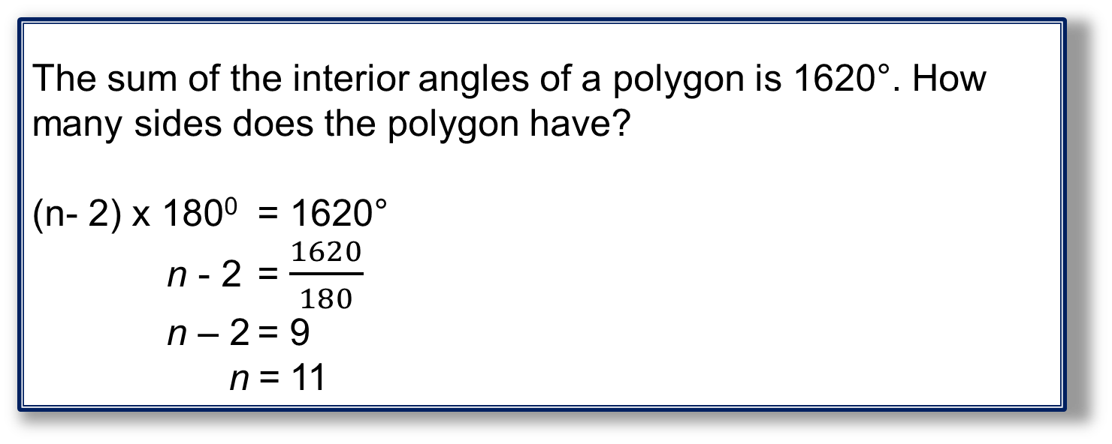
5.2 – Interior Angles of a Polygon
Page 127
Example 3
The sum of the interior angles of a polygon is 1620°. How many sides does the polygon have?
(n- 2) x 180⁰ = 1620°
n - 2 = $\frac{1620}{180}$
n – 2 = 9
n = 11
Form an equation using the sum of interior angles.
Divide both sides by 180⁰
Add 2 to both sides
Reasoning Q9 shows a pentagon made from isosceles triangles. What polygon can you make from equilateral triangles?
Reflect Besides triangles, which other regular polygons can fit together like this to create a pattern without leaving any gaps? Explain.

Slide 34
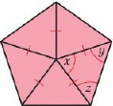
5.2 – Interior Angles of a Polygon
Page 127
Problem-solving A regular pentagon is divided into 5 isosceles triangles.
Work out the size of
  angle x b. angle y
  angle z.

Slide 35
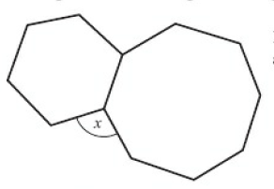
5.2 – Interior Angles of a Polygon
Page 128
11 – Exam-Style Questions
The diagram
shows a regular
hexagon and a
regular octagon.
Diagram NOT
accurately drawn
Calculate the size of the angle marked x.
You must show all your working.
(4 marks)
June 2012, Q13, 1MA0/1H
Exam hint
Mark the angles on the diagram as you work them out. White the angle property you use for each one

Slide 36
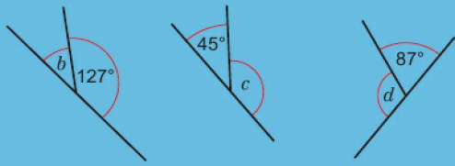

5.3 – Exterior Angles of a Polygon
Page 128
Objectives |  | Did you know?
Know the sum of the exterior angles of a polygon. Use the angles of polygons to solve problems |  | Polygons have been used for thousands of years to create decorative patterns called mosaics.
Fluency
Work out the sizes of the unknown angles.
ActiveLearn - Homework, practice and support: Higher 5.3

Slide 37
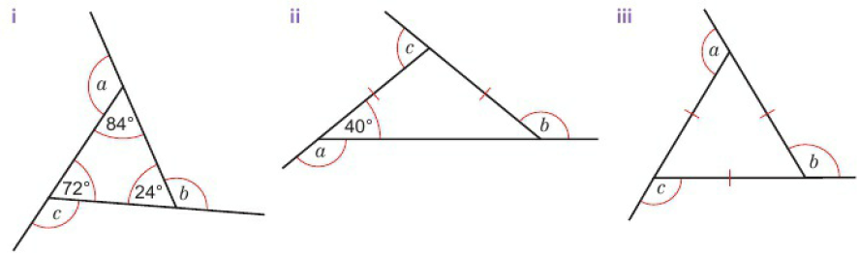
5.3 – Exterior Angles of a Polygon
Page 128
Work out the sum of the interior angles of:
  A heptagon b. A pentagon
  A decagon.
For each triangle work out:
  The sizes of angles a, b, and c.
  The value of a + b + c.
Warm Up

Slide 38
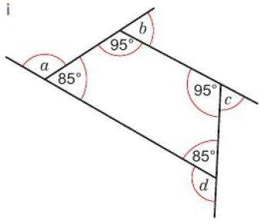
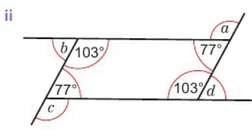
5.3 – Exterior Angles of a Polygon
Page 129
For each quadrilateral work out
  the sizes of angles a, b, c and d
  the value of a + b + c + d.
Warm Up

Slide 39
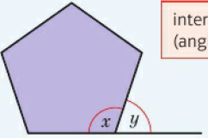
5.3 – Exterior Angles of a Polygon
Page 128
Key Point 4
When one side of a polygon is extended at a vertex:
angle x is the interior angle
angle y is the exterior angle.
interior angle + exterior angle = 180° (angles on a straight line add up to 180°)

Slide 40
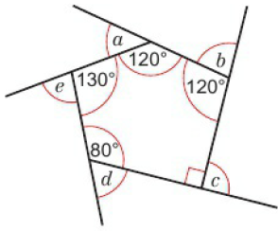
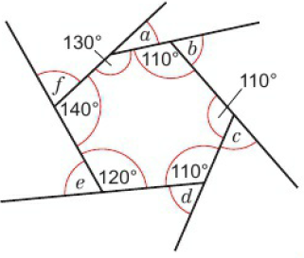
5.3 – Exterior Angles of a Polygon
Page 128
Reasoning A pentagon and a hexagon are shown.
  Work out the sizes of the angles marked with letters,
  Work out the sum of the exterior angles,
  What do you notice about the sum of the exterior angles? Discussion Does it matter if the polygon is regular or irregular?
Q4A hint - For the pentagon work out the value of a+b+c+d+e.

Slide 41
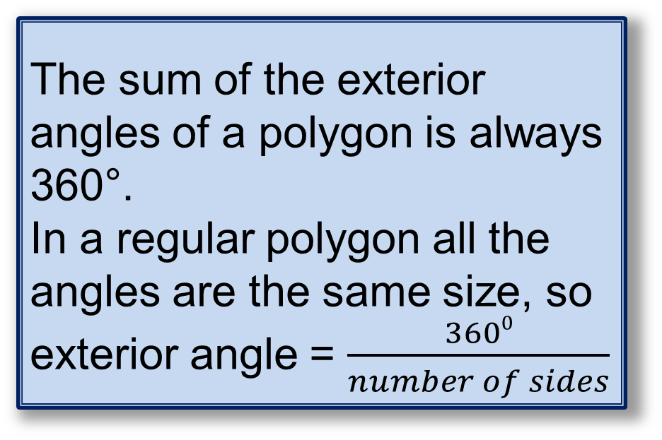
5.3 – Exterior Angles of a Polygon
Page 129
Key Point 5
The sum of the exterior angles of a polygon is always 360°.
In a regular polygon all the angles are the same size, so exterior angle = $\frac{3600}{number of sides}$
Work out the sizes of an exterior angle of a regular hexagon.

Slide 42
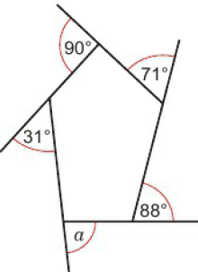
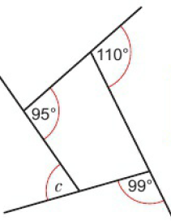
5.3 – Exterior Angles of a Polygon
Page 130
Work out the sizes of the angles marked with letters.
The first one has been started for you.
a + 31° + 90° + 71° + 88° = 360°

Slide 43
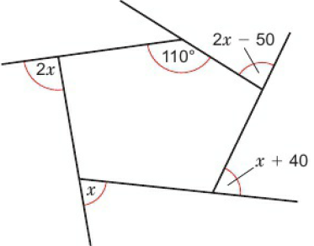
5.3 – Exterior Angles of a Polygon
Page 130
Reasoning The sizes of seven of the exterior angles of an octagon are 42°, 110°, 13°, 67°, 55°, 11° and 53°.
Work out the size of each interior angle.
Reasoning Work out the sizes of each unknown exterior angle in this polygon.
Q7 hint - Work out all eight interior angles.

Slide 44
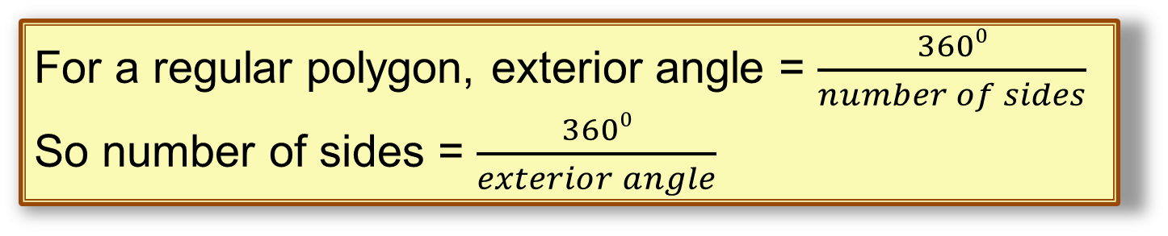

5.3 – Exterior Angles of a Polygon
Page 130
Example 4
Each interior angle of a regular polygon is 140°. How many sides does the polygon have?
Exterior angle = 180⁰ – 140⁰ = 40⁰
Number of sides = $\frac{3600}{400}$ = 9
Use interior angle + exterior angle = 180° to work out the size of an exterior angle.
For a regular polygon, exterior angle = $\frac{3600}{number of sides}$
So number of sides = $\frac{3600}{exterior angle}$

Slide 45
5.3 – Exterior Angles of a Polygon
Page 130
How many sides does a regular polygon have if its exterior angle is:
  10° b. 72° c. 20°?
How many sides does a regular polygon have if its interior angle is
  120° b. 150° c. 140°?
Reflect Can the exterior angle of a regular polygon be 70°?
Explain.

Slide 46

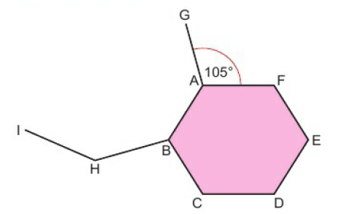
5.3 – Exterior Angles of a Polygon
Page 131
Problem-solving One side of a regular
hexagon ABCDEF forms the side of a regular polygon with n sides.
Angle GAF = 105°.
Work out the value of n.
Problem-solving The exterior
angle of a regular polygon is half
the size of its interior angle.
How many sides does the polygon have?
Q13 hint - Work out the size of the interior angle first.

Slide 47
5.4 – Pythagoras’ Theorem 1
Page 131
Objectives |  | Did you know?
Calculate the length of the hypotenuse in a right-angled triangle. Solve problems using Pythagoras' theorem. |  | Mesopotamian, Chinese and Indian mathematicians all independently discovered Pythagoras' theorem. However, the Greek Pythagoras ended up getting all the credit.
Fluency
Calculate a. 9² b. 12² c. 20² • Work out the area of a square of side length 11cm.
ActiveLearn - Homework, practice and support: Higher 5.4

Slide 48

5.4 – Pythagoras’ Theorem 1
Page 131
Work out:
    $\sqrt{200}$ b. $\sqrt{25}$
    $\sqrt{9}$ d. $\sqrt{49}$
a = 4.5 and b = 6.2
Work out
    a² + b² b. $\sqrt{\text{a}\text{2}\text{ + }\text{b}\text{2}}$
    Give your answers correct to 1 decimal place.
Find the positive solution of each equation.
Give your answers correct to 3 significant figures,
  x² = 12
  x² = 12² + 8²
Warm Up

Slide 49

5.4 – Pythagoras’ Theorem 1
Page 132
Key Point 6
In a right-angled triangle the longest side called the hypotenuse. Pythagoras' theorem states that, in a right-angled triangle, the square of the hypotenuse
is equal to the
sum of the
squares of the
other two sides.
c² = a² + b²

Slide 50


5.4 – Pythagoras’ Theorem 1
Page 132
Example 5
Calculate the length of the hypotenuse.
Give your answer correct to 2 significant
figures.
a = 5, b = 4, c = x
c² = a² + b²
x² = 5² + 4²
x² = 25 + 16
x² = 41
x = $\sqrt{41}$
x = 6.4031...
x = 6.4cm (to 2s.f)
Discussion Does it matter which side is a and which is 6?
Sketch the triangle. Label the hypotenuse c and the other two sides a and b.
Substitute the values of a, b and c into the formula for Pythagoras' theorem.
Use a calculator to find the square root.
Round your answer to 2 significant figures and put the units in your answers.

Slide 51

5.4 – Pythagoras’ Theorem 1
Page 132
Reflect Dawn and Eleri are answering the same question. Parts of their working are shown.
Dawn’s working Eleri’s working
x2 = 33.846 x2 = 33.846
x = $\sqrt{33.8}$ x = $\sqrt{33.846}$
x = _______ x = ________
  Which working is the more accurate? Why?
  Will the accuracy of the working affect the answer?
Real A zip wire runs from a vertical height of 20 feet. The total horizontal distance travelled is 32 feet.
What is the length of the zip wire?

Slide 52



5.4 – Pythagoras’ Theorem 1
Page 132
Calculate the length of the hypotenuse in each triangle. Give your answers correct to 2 significant figures.
Q5 hint - Do not round before taking the square root. Use all the figures on your calculator display.

Slide 53

5.4 – Pythagoras’ Theorem 1
Page 133
ABC is a right-angled triangle. Calculate the length of AC. Give your answer
correct to 3
significant
figures.
Calculate the length of the diagonal of a rectangle measuring 5cm by 3.5 cm.
Discussion What is a sensible rounding for the answer to this question? Why?
Q9f strategy hint - Sketch a right- angled triangle and label it.
State the degree of accuracy after your answer e.g. 2 s.f. or 1 d.p.

Slide 54

5.4 – Pythagoras’ Theorem 1
Page 133
Problem-solving A ship sails 5 miles North and then 8.1 miles East.
It then returns directly to its starting point. What is the total distance the ship travels?
Real / Problem-solving A roof truss is made of wood. The vertical support bisects the horizontal span.
Work out the total length of wood needed to make the truss.
Q9 hint - The question is asking for the total distance.
Q10 communication hint - Bisect means divide in half.

Slide 55

5.4 – Pythagoras’ Theorem 1
Page 133
11 – Exam-Style Questions
ABCD is a
trapezium.
AB = 6 cm
BC = 8cm
AD = 12 cm
Calculate the
perimeter of ABCD.
Give your answer correct to 1 decimal place. (3 marks)
Exam hint
Divide the shape into a rectangle and a right- angled triangle and then fill in the measurements of the sides of the triangle.

Slide 56

5.4 – Pythagoras’ Theorem 1
Page 133
Key Point 1
A triangle with sides a, b and c, where c is the longest side, is right-angled only if c² = a² + b².
Reasoning Can a right-angled triangle have sides of length
  4cm, 5cm,8cm
  9cm, 12cm, 15cm
  5cm, 12cm, 13cm?
  Explain your answers.
Q12a hint - If the
triangle is right
angled, the longest
side will be the
hypotenuse.

Slide 57

5.5 – Pythagoras’ Theorem 2
Page 134
Objectives |  | Why learn this?
Calculate the length of a shorter side in a right-angled triangle. Solve problems using Pythagoras' theorem. |  | Pythagoras' theorem is used to calculate the distances travelled by aircraft.
Fluency
Find a. $\sqrt{16}$ b. $\sqrt{100}$ c. $\sqrt{25}$ Which of these have an exact answer? $\sqrt{9}$, $\sqrt{5}$, $\sqrt{64}$, $\sqrt{37}$
ActiveLearn - Homework, practice and support: Higher 5.5

Slide 58

5.5 – Pythagoras’ Theorem 2
Page 134
Calculate the length of the hypotenuse in this right-angled triangle. Give your answer correct to 1 decimal place.
Solve these equations.
  5² = a² + 4²
  10² = 6² + b²
  5² + c² = 13²
Warm Up

Slide 59


5.5 – Pythagoras’ Theorem 2
Page 134
Example 6
Calculate the length m in this right-angled triangle.
Give your answer correct to 3 significant figures.
c² = a² + b²
9² = m² + 4²
81 = m² + 16
m² = 81 – 16 = 65
m = $\sqrt{65}$
m = 8.0622...
m = 8.06cm (to 3s.f)
Discussion Does it matter which side is a and which is 6?
Sketch the triangle. Label the hypotenuse c and the other two sides a and b.
Substitute the values of a, b and c into Pythagoras' theorem.
Solve the equation
Use a calculator to find the square root.
Round your answer to 3 s.f. and include the units.

Slide 60

5.5 – Pythagoras’ Theorem 2
Page 134
3 – Exam-Style Questions
ABC is a right-angled triangle.
AC = 6cm AB = 13 cm
Calculate the length of BC.
Give your answer correct to 3 significant figures. (3 marks)
March 2013, Q13, 1MA0/2H
Exam hint
Label a, b and c on the diagram. Write down the theorem you use before you substitute in.

Slide 61

5.5 – Pythagoras’ Theorem 2
Page 135
Modelling / Real A ladder of length 5 m leans against a vertical wall.
The foot of the ladder is 4.2 m from the base of the wall.
How far is the
top of the
ladder from
the ground?
Q4 hint - State the degree of accuracy after your answer.

Slide 62

5.5 – Pythagoras’ Theorem 2
Page 135
Modelling / Real A ramp is to be used to go up one step.
The ramp is 3 m long.
The step is 30 cm high.
How far away from the step (x) does the ramp start? Give your answer in metres, to the nearest centimetre.
Q5 hint - Convert lengths to the same units.

Slide 63

5.5 – Pythagoras’ Theorem 2
Page 135
Modelling / Real Calculate the vertical height of trapezium ABCD.
Give your answer in centimetres, to the nearest millimetre.
Problem-solving a. Calculate the length of the side of the largest square that fits inside a 12 cm diameter circle.
  Work out the length of the side of the smallest square that surrounds a 12 cm diameter circle.

Slide 64




5.5 – Pythagoras’ Theorem 2
Page 135
Work out the length of the unknown side in each right-angled triangle. Give your answers in surd form.
a
b
C
Q3 hint – Simplify the surd so your answer looks like this:
AC = ◻$\sqrt{\text{◻}}$ cm
Q8 communication hint - Giving an answer in 'surd form' means don't work out the square root.

Slide 65
5.5 – Pythagoras’ Theorem 2
Page 136
Problem-solving ABC is an equilateral triangle.
D id the midpoint of BC.
Work out the height of the triangle.
Give your answer in surd form.

Slide 66

5.5 – Pythagoras’ Theorem 2
Page 136
Problem-solving Work out:
  The length of AD
  The length of CD
  The perimeter of the triangle.
  Give all your answers to 3 s.f.

Slide 67


5.6 – Trigonometry 1
Page 134
Objectives |  | Did you know?
Use trigonometric ratios to find lengths in a right-angled triangle. Use trigonometric ratios to solve problems. |  | Trigonometry was used to map the British Isles.
Fluency
Convert each fraction to a decimal, $\frac{1}{2}$, $\frac{1}{4}$, $\frac{1}{5}$, $\frac{1}{10}$, $\frac{2}{5}$ Name the hypotenuse in each triangle.
ActiveLearn - Homework, practice and support: Higher 5.6

Slide 68


5.6 – Trigonometry 1
Page 136
Work out the size of each unknown angle.
Warm Up

Slide 69


5.6 – Trigonometry 1
Page 136
Solve these equations, correct to 2 decimal places where necessary.
  $\frac{x}{5}$ = 4 b. $\frac{10}{x}$ = 5
  3.5 = $\frac{3}{2.1}$ d. 9.5 = $\frac{10}{x}$
Warm Up
Key Point 1
The side opposite the right angle is called the hypotenuse. The side opposite the angle ϴ is called the
opposite.
The side next to the
angle ϴ is called the
adjacent.

Slide 70

5.6 – Trigonometry 1
Page 137
Reasoning Draw triangle ABC accurately using a
ruler and protractor.
Angle A = 90°, angle B = 30° and AB = 5 cm.
  Label the hypotenuse (hyp), opposite side (opp) and adjacent side (adj).
  Measure each unknown side to the nearest millimetre,
  Write the fraction
    $\frac{opposite}{hypotenuse}$ ii. $\frac{adjacent}{hypotenuse}$ iii. $\frac{opposite}{adjacent}$
  Convert each fraction to a decimal.
  Give your answer correct to 1 decimal place,
  Repeat parts a to c for triangle ABC with
    angle A = 90°, angle B = 30° and AB = 7 cm
    angle A = 90°, angle B = 30° and AB = 8cm
  Discussion What do you notice about the ratios of sides in a triangle with angles 30°, 60° and 90°?

Slide 71

5.6 – Trigonometry 1
Page 137
Key Point 9
In a right-angled triangle:
The sine of angle ϴ is the ratio of the opposite side to the hypotenuse, sin ϴ = $\frac{opp}{hyp}$
The cosine of angle ϴ is the ratio of the adjacent side to the hypotenuse, cos ϴ = $\frac{adj}{hyp}$
The taangent of angle ϴ is the ratio of the opposite side to the adjacent side, tan ϴ = $\frac{opp}{adj}$
You car find the sine, cosine and tangent of an angle using the keys on your calculator.
sin
cos
tan

Slide 72
5.6 – Trigonometry 1
Page 137
Use your calculator to find, correct to 1 decimal place where necessary
  sin 35° b. cos 17°
  tan 82° d. cos 73°
  tan 12° f. tan 49
Reflect The mnemonic SOHCAHTOA can be used to remember the sine, cosine and tangent ratios.
Does it help you? Can you devise a mnemonic of your own?
Q4 hint – Press
on your calculator.
sin
3
5
=

Slide 73

5.6 – Trigonometry 1
Page 137
Example 6
Calculate the length of the side marked x.
Give your answer correct to 3 significant
figures.
sin ϴ = $\frac{opp}{hyp}$
Sin 32⁰ = $\frac{x}{10}$
x = 10 x sin32⁰
x = 5.2991…
x = 5.30cm (to 3s.f)
You are given ‘opp’ and ‘hyp’ so use the sine ratio
Substitute the sides and angle into the sine ratio.
Rearrange and make x the subject
Use your calculator to work out 10 x sin32⁰
Round your answer to 3 s.f. and put in the units.

Slide 74






5.6 – Trigonometry 1
Page 138
Calculate the length of the side marked x in each triangle.
Give your answers correct to 3 significant figures.
b
a
Q5a hint – use the sin ϴ = $\frac{opp}{hyp}$
c
Q5b hint – use the tan ϴ = $\frac{opp}{adj}$

Slide 75

5.6 – Trigonometry 1
Page 138
Calculate the length of the side marked x. Give your answer correct to 1 decimal place.
Q7 hint – You are given adj and hyp so use the cosine ratio.

Slide 76
5.6 – Trigonometry 1
Page 138
Calculate the length of the side marked x in each triangle. Give your answers correct to 1 decimal place.
b
a
c

Slide 77
5.6 – Trigonometry 1
Page 138
9 – Exam-Style Questions
Calculate the
value of x.
Give your
answer correct
to 3 significant
figures.
(3 marks)
Nov 2012, Q17, 1MA0/2H
Exam hint
Use SOHCAHTOA to write an equation involving x. Show your unrounded answer to at least 5 digits before rounding to 3 s.f.

Slide 78

5.6 – Trigonometry 1
Page 139
Problem-solving / Reasoning A shed roof makes an angle of 41° with the horizontal.
The width of the shed is 6 m. The length of each slope is 4 m. Calculate the height of the roof.

Slide 79

5.6 – Trigonometry 1
Page 139
Key Point 10
The angle of elevation (e) is the angle measured upwards from the horizontal.
The angle of depression (d) is the angle measured downwards from the horizontal.
Real Modelling A ladder 7m long is leaning against a
wall. The angle of
elevation is 72⁰.
What height
does the ladder
reach.
Q11 strategy hint – use a sketch

Slide 80

5.7 – Trigonometry 2
Page 134
Objectives |  | Did you know?
Use trigonometric ratios to calculate an angle in a right-angled triangle. Find angles of elevation and angles of depression. Use trigonometric ratios to solve problems. Know the exact values of the sine, cosine and tangent of some angles. |  | A sextant is a navigation tool used at sea. It uses trigonometry to calculate the angle between two fixed points.
Fluency
Name the opposite and adjacent sides in these triangles.
ActiveLearn - Homework, practice and support: Higher 5.7

Slide 81
5.7 – Trigonometry 2
Page 140
Use your calculator to find, correct to 2 decimal places
  tan 49° b. cos 16°
  cos 75⁰
ABC is a right-angled triangle.
Calculate the length of AB, correct to 2 decimal places.
Warm Up

Slide 82


5.7 – Trigonometry 2
Page 140
Key Point 11
Q3 communication hint - Correct to 0.1° means give your answer to 1 d.p.
If the lengths of two sides of a right-angled triangle are given, you can find a missing angle using the inverse trigonometric functions:
sin⁻¹ cos⁻¹ tan⁻¹
Make sure you know how to use sin⁻¹,
cos⁻¹ and tan⁻¹ on your calculator.
Q3d hint - Enter $\frac{4}{5}$ as a fraction.
Use the inverse function on your calculator to find the value of ϴ correct to 0.1°.
  sin ϴ =0.562 b. cos ϴ = 0.805
  tan ϴ = 0.246 d. sin ϴ = $\frac{4}{5}$
  cos ϴ = $\frac{11}{14}$ f. tan ϴ = $\frac{8.5}{11.5}$

Slide 83

5.7 – Trigonometry 2
Page 140
Example 8
Calculate the size of angle x.
Angle = x
Opposite = 5cm
Hypotenuse = 9cm
sin ϴ = $\frac{opp}{hyp}$
Sin x = $\frac{5}{9}$
x = sin⁻¹$(\frac{5}{9}$)
x = 33.7489
x = 33.7cm (to 1d.p.)
Identify the information given: angle, opposite and hypotenuse
You are given ‘opp’ and ‘hyp’ so use the sine ratio
Substitute the sides and angle into the sine ratio.
Use sin⁻¹ to find the angle
Round your answer up to 1 d.p..

Slide 84






5.7 – Trigonometry 2
Page 140
Calculate the size of angle x in each triangle. Give your answers correct to 1 decimal place.
Q4a hint – Use
sin x = $\frac{opp}{hyp}$
Q4b hint – Use
cos x = $\frac{adj}{hyp}$
Q4c hint – Use
tan x = $\frac{opp}{adj}$

Slide 85

5.7 – Trigonometry 2
Page 141
5 – Exam-Style Questions
LMN is a right-
angled triangle.
MN = 9.6 cm.
LM = 6.4 cm.
Calculate the Diagram not drawn accurately
size of the angle marked x°.
Give your answer correct to 1 decimal place. (3 marks)
June 2012, QI6, 1MA0/2H
Exam hint
Do not round until the very accurately drawn end of your calculation.

Slide 86

5.7 – Trigonometry 2
Page 141
Real / Problem-solving A flagpole is secured to the ground by wires. Each wire is 4 m long.
The wires attach to the flagpole at a height of 3 m.
What is the size of the angle (x) the wire makes with the ground?

Slide 87

5.7 – Trigonometry 2
Page 141
Real / Problem-solving A tree 20 m in height stands on horizontal ground. Work out the angle of elevation of the top of the tree from point A.
Discussion How can you work out the angle of depression of point A from the top of the tree?

Slide 88

5.7 – Trigonometry 2
Page 141
Real / Problem-solving From P, a ship sails 3 km East and then 5 km North to its destination.
A helicopter flies from P directly to the ship,
  How far does the helicopter fly?
  On what angle (x) from North should the
  helicopter fly?
  Give your
  answers correct
  to 1 decimal
  place.
Q8a hint – Use Pythagoras’ theorem

Slide 89

5.7 – Trigonometry 2
Page 141
Real / Problem-solving From the top of a vertical cliff, 65 m high, a lifeguard can see a boat out at sea. The boat is 42 m from the base of the cliff.
What is the angle of depression of the boat from the top of the cliff?
Problem-solving Work out the area of this isosceles triangle.
Q9 hint – Sketch and label a right-angled triangle to show this information.

Slide 90

5.7 – Trigonometry 2
Page 142
Problem-solving Calculate the size of angle ϴ in this diagram.

Slide 91


5.7 – Trigonometry 2
Page 142
ABC is an isosceles triangle,
  Use the diagram to write the value of tan 45°.
  Use Pythagoras' theorem to find the length of BC. Leave your answer in surd form,
  Write these ratios as exact values using surds,
    sin 45° ii. cos 45°

Slide 92


5.7 – Trigonometry 2
Page 142
ABC is an
equilateral triangle.
D is the midpoint
of AC.
  Use the diagram
  to write these
  ratios as fractions,
    cos 60° ii. sin 30°
  Work out the length of BD. Leave your answer in surd form.
  Write these ratios as exact values using surds,
    sin 60° ii. tan 60°
    cos 30° iv. tan 30°
Q13a hint - Sketch right-angled triangle ABD. Add length AD and angle ABD to your diagram.
Q13ci hint –
Your answer
should look like this:

Slide 93

5.7 – Trigonometry 2
Page 142
Key Point 12
The sine, cosine and tangent of some angles may be written exactly.
 | 30⁰ | 45⁰ | 60⁰ | 0 | 90⁰
sin | $$\frac{1}{2}$$ | $$\frac{\sqrt{2}}{2}$$ | $$\frac{\sqrt{3}}{2}$$ | 0 | 1
cos | $$\frac{\sqrt{3}}{2}$$ | $$\frac{\sqrt{2}}{2}$$ | $$\frac{1}{2}$$ | 1 | 0
tan | $$\frac{\sqrt{3}}{3}$$ | 1 | $$\sqrt{3}$$ | 0

Slide 94



5.7 – Trigonometry 2
Page 143
Find the exact value of x in these triangles.
Q14 strategy hint - Sketch the triangle. Label the hyp, opp and adj.
Decide on the ratio to use by looking at Key point 12.
Substitute the values you are given.

Slide 95


5 – Prolem Solving
Page 143
Objectve
Use x for the unknown to help you solve problems.
Example 8
In this quadrilateral, angles PQR and QRS are equal. Angle PSR is $\frac{4}{7}$ angle QRS. Angle QPS is $\frac{6}{7}$ angle QRS.
Find angle PSR.
Show that angle QPS is a right angle.
Sketch the diagram and write your findings on it as you go.

Slide 96


5 – Problem Solving
Page 143
Objectve
Use x for the unknown to help you solve problems.
Example 8
Let angle QRS be x.
Angle PSR = $\frac{4}{7}$x.
Angle QPS = $\frac{6}{7}$x.
Angles in the quadrilateral PQRS = x + x + $\frac{4}{7}$x + $\frac{6}{7}$x = $\frac{24}{7}$x = 360⁰
Therefor x = $\frac{7}{24}$ x 36- = 105⁰
Angle PSR = $\frac{4}{7}$x = $\frac{4}{7}$ x 105 = 60⁰
Angle QPS = $\frac{6}{7}$x = $\frac{6}{7}$ x 105 = 90⁰
Therefor QPS is a right angle.
Angle QPS is used to define a lot of other angles. So call this ‘unknown’ angle x^{0.}
Angles in a quadrilateral add up to 360⁰.
Write and solve an equation
Use the fact that PST = $\frac{4}{7}$x
Show that angle QPS is a right angle, i.e. 90⁰.

Slide 97

5 – Problem Solving
Page 144
In this triangle, angle BAC is 25% of angle ABC. The ratio angle ACB : angle ABC is 1:4
  What is the size of angle ABC?
  What kind of
  triangle is this?
Q1 hint - Copy the diagram. Call angle ABC x. Rewrite the percentage and ratio as fractions, then label the other angles in terms oft x.

Slide 98

5 – Problem Solving
Page 144
Antony thinks of three numbers.
  The second number is A times the first.
  The third number is 4 less than the second.
  The first number multiplied by the second number is 25.
  Find the three numbers.
A rectangle has a length twice its width. Its diagonal is $\sqrt{45}$cm.
What are the length and width of the rectangle?
Q2 hint - Let the first number be x.
Q3 hint - Draw a rectangle with a diagonal. Label the shorter sides x.

Slide 99

5 – Problem Solving
Page 144
This brand logo is a heptagon with a vertical line of symmetry. Angle A is three times angle C. Angle B is four times angle C. Angle D is
260°. Find
angles E,
F and G.
Q5 hint - Sketch the diagram. Angle C seems important (it is mentioned twice) so call it x.
Label the other angles in terms of x, then use these to form an equation.

Slide 100
5 – Problem Solving
Page 144
A right-angled triangle has a hypotenuse that is 1.6 times the length of the base. What are its angles?
Reflect Choose A, B or C:
Solving problems by using x for the unknown is:
  always easy
  sometimes easy, sometimes hard
  always hard
  Discuss with a classmate or your teacher what you did find easy or hard.

Slide 101

5 – Check up
Page 144
5. Check up
Log how you did on your Student Progression Chart
Angles and polygons
a. What is the size of each interior angle of a regular decagon?
  What is the size of an exterior angle of a regular pentagon?
Part of a regular polygon is shown.
How many sides does the polygon have?
ActiveLearn - Homework, practice and support: Higher 5 Check Up

Slide 102


5 – Problem Solving
Page 145
Work out the
size of
angle x.
Work out the size of angle ABE. Give reasons for your working.

Slide 103

5 – Problem Solving
Page 145
DEA is a straight line. ABEF is a rectangle. Angle ACD = 90° and angle EAB = 36°.
Work out the size of angle DEB.
Give reasons for your working.

Slide 104


5 – Problem Solving
Page 145
Communication Show that for any quadrilateral
a + b + c + d= 360°
Reasoning BCD is an isosceles triangle. AC is parallel to ED.
AE is parallel to BD.
Angle BAE = 62°. Work out the size of the angle marked x.
Give reasons for your working.

Slide 105


5 – Problem Solving
Page 146
Pythagoras’ theorem
Calculate the length of x in each right-angled triangle. Give your answers correct to 2 significant figures.

Slide 106

5 – Problem Solving
Page 146
Pythagoras’ theorem
Reasoning A triangle has sides of length 3cm, 6cm and 7cm. Is the triangle a right-angled triangle? Explain your answer.
Work out the length of AC in this right-angled triangle.
Give your answer in surd form.

Slide 107


5 – Problem Solving
Page 146
Trigonometry
Calculate the length of the side marked x in each triangle. Give your answers correct to 3 significant figures.

Slide 108

5 – Problem Solving
Page 146
Trigonometry
Calculate the size of angle y in this triangle. Give your answer correct to 3 significant figures.
A kite is flying at a height of 11.7 m.
The string of the kite is 14 m long.
What is the angle of elevation of the kite? Give your answer correct to 1 decimal place.

Slide 109

5 – Problem Solving
Page 147
Write down the value of
  tan 45° b. sin 30° c. cos 60°
How sure are you of your answers? Were you mostly
Just guessing ☹
Feeling doubtful 😐
Confident ☺
What next? Use your
results to decide whether
to strengthen or extend
your learning.
* Challenge
The square and the
isosceles triangle have the
same area. Find tan ϴ.
Reflect
Not to scale

Slide 110



5 – Strengthen
Page 147
Angles and polygons
Reasoning Mario divides some shapes into triangles to work
out the sum of the interior angles. a. Copy and complete his table.
  Copy and complete Mario's working to find an expression for the sum of the interior angles of any polygon.
  Number of sides = n Sum of interior angles = (n - __) x ___°
  Number of triangles = n - ____
  Work out the sum of the interior angles of a decagon.
Polygon | Quadrilateral | Pentagon | Hexagon | Heptagon
Number of sides (n) | 4
Number of triangles | 2
Sum of interior angles | 2 x 180⁰ = 360⁰
Q1c hint – Use your answer to part b.

Slide 111
5 – Strengthen
Page 148
Work out the size of each interior angle of these shapes. The first one has been started for you.
  a regular nonagon
  Sum of interior angles = (n -_) x ___°
  = (9 - __) x __“
  Interior angle =____° ÷ 9
  a regular polygon with 12 sides
  a regular polygon with 20 sides.
The sum of the exterior angles of any polygon is 360°.
What is the size of an exterior angle of a
  regular quadrilateral
  regular decagon
  regular polygon with 18 sides?
Q2 communication hint - In a regular polygon all the sides and all the angles are equal
Q3 hint - Divide 360° by the number of sides.

Slide 112


5 – Strengthen
Page 148
a. Rearrange the formula to make n, number of sides, the subject, exterior angle = $\frac{3600}{n}$
  How many sides does a regular polygon have if the exterior angle is
    90° ii. 60°
    30° iv. 12°?
Q4b hint Use your answer to part a.

Slide 113

5 – Strengthen
Page 148
Part of a regular polygon is shown.
  Identify the interior and exterior angle,
  Work out the size of x.
  How many sides does the polygon have?
Q5b hint - Use the fact that angles on a straight line add up to 180°.

Slide 114

5 – Strengthen
Page 148
a. What is the sum of the interior angles of a hexagon?
  Work out the size of x.
Q6b hint - Use your answer to part a to form an equation.
x + 110° + 80° + 130° + 115° + 120° = ___⁰
Solve it for x6

Slide 115

5 – Strengthen
Page 148
Communication Work out the size of angle ABC. Give reasons for your working. The working has been started for you.
x + 3x + x + 5 + x + 7 = ___°
(angles in a quadrilateral ______)
6x + ___ = ___°
6x = ___°
x = ___°
Q7 hint – have you answered the question asked

Slide 116

5 – Strengthen
Page 149
Reasoning / Communication Work out the value of x and y. Give reasons for your working.
Q8 hint – Use these reasons:
Alternate angles are equal.
Angles in a triangle sum to 180°.
Base angles of an isosceles triangle are equal. Angles on a straight line add up to 180°.

Slide 117

5 – Strengthen
Page 149
Reasoning / Communication Are these statements true or false? Explain your answers,
  m = x b. z = x + y
  m = y + z d. m = 180° - x
  x = 180° - (y + z)

Slide 118


5 – Strengthen
Page 149
Reasoning Copy each diagram
  Write x in all the angles equal to x in each diagram.
  Write y in all the angles equal to 180 - x in each diagram.
  Look at your diagram for part ii. What properties of parallelograms are shown?

Slide 119




5 – Strengthen
Page 149
Pythagoras' theorem 1
Name the hypotenuse in each triangle.
Q1 hint - The hypotenuse is the longest side and is opposite the right angle.

Slide 120


5 – Strengthen
Page 149
The hypotenuse of this right-angled triangle is labelled c. Copy and complete these steps to find the value of c.
  c² = 8² + __²
  c² = _____
  c = $\sqrt{____}$
  c = __ cm
Q2 hint - In a right-angled triangle, the square of the hypotenuse is equal to the sum of the squares of the other two sides. This is Pythagoras' theorem.

Slide 121

5 – Strengthen
Page 150
Calculate the length of c in these right-angled triangles Round your answer to 1 decimal place where necessary
Q3 hint - Use the same method as in Q2.
Q3b hint - Do not round before taking the square root. You should find the square root of 650.25.

Slide 122


5 – Strengthen
Page 150
One of the shorter sides of this right-angled triangle is labelled b.
Copy and complete these steps to find the value of b.
c² = a² + b²
10² = __ ² + b²
100 = ___ + b²
b = $\sqrt{___}$
b = ___ cm
Q4 hint - Pythagoras' theorem: c² = a^{z} + b^{2.}

Slide 123


5 – Strengthen
Page 150
Calculate the length x in each right-angled triangle, correct to 2 d.p. where necessary.
Q5a hint - Check your answer

Slide 124

5 – Strengthen
Page 150
Reasoning Aaron says, 'Triangle ABC is right-angled’. Is Aaron correct? Explain.
Q6 hint - A triangle is only right-angled if c² = a² + b², where c is the longest side. Start:
c² = 18² = ... a² + b² = ...

Slide 125



5 – Strengthen
Page 150
Work out the value of x in each right-angled triangle. Give your answers in surd form.
Q7 hint - Make sure any surds are in their simplest form.

Slide 126



5 – Strengthen
Page 151
Trigonometry
Sketch these triangles and label the hypotenuse, opposite and adjacent sides.

Slide 127

5 – Strengthen
Page 151
Trigonometry
Write sin x, cos x
and tan x as
fractions for this
triangle. The first
one has been
started for you.
sin x = $\frac{opposite}{hypotenuse}$ = $\frac{◻}{◻}$
Use your calculator to find, correct to 2 decimal places
  sin 22° b. tan 36°
  cos 70° d. Tan 58⁰
Q2 hint - Use SOH CAH TOA.

Slide 128

5 – Strengthen
Page 151
Trigonometry
Copy and complete. Use your calculator to find each angle to 1 decimal place,
  tan x = 0.345 x = tan⁻¹(◻)
  sin ϴ = 0.806 ϴ = ◻⁻¹(0.806)
  Cos y = 0.7625 y = cos⁻¹(◻)
  sin a = $\frac{2}{3}$ a = ◻⁻¹($\frac{2}{3}$)
  cos b = $\frac{4.8}{5.1}$ b = cos⁻¹(◻)

Slide 129


5 – Strengthen
Page 151
Sophie is calculating the length of the side marked x in this triangle.
Copy and complete her working.
SOH CAH TOA
  tan = $\frac{opp}{adj}$
  tan 36⁰ = $\frac{x}{5}$
  x = 5x ___
  x = _______
Q5 hint - Round your answer to 1 d.p. and put in the units.

Slide 130


5 – Strengthen
Page 151
Calculate the length of the side marked x in each triangle. Give your answers correct to 1 decimal place.
Q6 hint - Use the same method as in Q5.
Write SOH CAH TOA. Underline the information you are given.
Use the ratio with two underlines.

Slide 131


5 – Strengthen
Page 152
Calculate the size of angle x.
The working has been started for you.
SOH CAH TOA
  cos = $\frac{adj}{◻}$
  cos x⁰ = $\frac{◻}{◻}$
  x = cos⁻¹ ($\frac{◻}{◻})$
  x = ___ ⁰
Q7 hint - Round your answer to 1 d.p.

Slide 132

5 – Strengthen
Page 152
Calculate the size of angle ABC in this triangle. Give your answer correct to 0.1°.
Q8 hint – Sketch triangle ABC.
Label angle ABC
The use the same method as in Q8.

Slide 133

5 – Strengthen
Page 152
Which angle in an angle of elevation and
which is an
angle of
depression?
        Copy and complete this table. Leave your answers in surd form.
 | 30⁰ | 45⁰ | 60⁰ | 0 | 90⁰
sin
cos
tan
Q11 hint - Look back at Key point 12.

Slide 134

5 – Strengthen
Page 152
Real / Problem-solving From the top of a vertical cliff, C, a boat, B, can be seen out at sea. The cliff is 90 m high. The boat is 110 m from the base of the cliff,
  Copy and
  complete the
  diagram to
  show the
  information
  you are given.
  What is the angle of elevation of the cliff top from the boat? Give your answer correct to 1 decimal place.
Q10b hint - Find the angle at B.

Slide 135


5 – Extend
Page 153
Problem-solving A rectangle BCEF is constructed inside a regular hexagon ABCDEF. Work out the size of angle DEC.
Problem-solving Work out the size of angle QSP. Give reasons for your working.

Slide 136

5 – Extend
Page 153
2 – Exam-Style Questions
ABCDE is a
regular pentagon.
BCF and EDF
are straight lines.
Work out the size
of angle CFD.
You must show how you got your answer. (3 marks)
June 2014, Q11, 1MA0/1H
Exam hint
You could start by working out the size of the exterior angles of the pentagon.

Slide 137

5 – Extend
Page 153
4 – Exam-Style Questions
A BCD is a
trapezium.
AD = 10 cm,
AB = 9 cm,
DC = 3 cm
Angle ABC = angle BCD = 90°
Calculate the length of AC.
Give your answer correct to 3 significant figures. (5 marks)
Nov 2012, Q15, 1MA0/2H
Exam hint
Divide the trapezium into a rectangle and a triangle and put on the sizes of the three sides of the triangle Calculate the length BC first.

Slide 138
5 – Extend
Page 153
Problem-solving A rectangular garden measures 25 m by 20 m.
A path is laid diagonally across the garden and along the whole of its perimeter.
What is the total length of the path?
Problem-solving The ratio of the interior angles of a pentagon is 1:2:3:4:5. Work out the sizes of all five interior angles.
Problem-solving The exterior and interior angles of a regular polygon are in the ratio 1:2. How many sides does the polygon have?

Slide 139

5 – Extend
Page 154
Problem-solving The area of triangle ABC is 42 cm².
Calculate the
size of angle x.
Give your
answer correct to 1 decimal place.
Reasoning Sarah sees an aeroplane.
She estimates it is flying at a height of 56 000 feet. The angle of elevation to the aeroplane is 49°.
What is the horizontal distance between Sarah and the plane? Give your answer correct to 3 sf.

Slide 140

5 – Extend
Page 154
  Find the length (to 2 d.p.) of
    AB ii. AC.
  Work out the perimeter of the triangle.
Problem-solving In a right-angled triangle the shortest side is 4cm and the longest side is 8 cm.
Work out the exact perimeter of the triangle.

Slide 141

5 – Extend
Page 154
Problem-solving The diagram shows a circle centre O. Angle OBA is 90°.
  Work out the radius of the circle,
  Work out angle OCB.

Slide 142


5 – Knowledge Check
Page 155
5. Knowledge Check
The angle marked x is called the interior angle. The angle marked y is called the exterior angle. x + y = 180° (angles on a straight line add up to 180°) For any polygon, interior angle + exterior angle = 180°. The exterior angle of a triangle is equal to the sum of the interior angles at the other two vertices. angle d = angle a + angle b
Mastery
Lesson 5.1
Mastery
Lesson 5.3
Mastery Lesson 5.1

Slide 143

5 – Knowledge Check
Page 155
5. Knowledge Check
The sum of the interior angles of a polygon with n sides = (n - 2) x 180°. The sum of the exterior angles of a polygon is always 360°. The exterior angle of a regular n-sided polygon is. In a right-angled triangle the longest side is called the hypotenuse and is opposite the right angle. Pythagoras' theorem states that in a right-angled triangle, the square of the hypotenuse is equal to the sum of the squares of the other two sides. c² = a² + b².
Mastery
Lesson 5.2
Mastery
Lesson 5.3
Mastery
Lesson 5.4
Mastery Lesson 5.4

Slide 144

5 – Knowledge Check
Page 155
5. Knowledge Check
A triangle with sides a, b and c, where c is the longest side, is right-angled only if c² = a² + b². In a right-angled triangle, the side opposite the angle ϴ is called the opposite. The side next to the angle ϴ is called the adjacent. The sine of angle ϴ is the ratio of the opposite side to the hypotenuse, sin ϴ = $\frac{opp}{hyp}$ The cosine of angle ϴ is the ratio of the adjacent side to the hypotenuse, cos ϴ = $\frac{adj}{hyp}$ The tangent of angle 8 is the ratio of the opposite side to the adjacent side, tan ϴ = $\frac{opp}{adj}$
Mastery
Lesson 5.4
Mastery
Lesson 5.4
Mastery Lesson 5.6

Slide 145

5 – Knowledge Check
Page 115655
5. Knowledge Check
You can use sin⁻¹, cos-1 or tan⁻¹ on your calculator to find an angle when you know its sin, cos or tan. The angle of elevation (e) is the angle measured upwards from the horizontal. The angle of depression d) is the angle measured downwards from the horizontal.
Mastery
Lesson 5.7
Mastery
Lesson 5.6

Slide 146

5 – Knowledge Check
Page 156
5. Knowledge Check
The sine, cosine and tangent of some angles may be written exactly...
Mastery
Lesson 5.7
 | 30⁰ | 45⁰ | 60⁰ | 0⁰ | 90⁰
Sin | ½ | $$\frac{\sqrt{2}}{2}$$ | $$\frac{\sqrt{3}}{2}$$ | 0 | 1
Tan | $$\frac{\sqrt{3}}{2}$$ | $$\frac{\sqrt{2}}{2}$$ | ½ | 1 | 0
Cos | $$\frac{\sqrt{3}}{2}$$ | 1 | $$\sqrt{3}$$ | 0

Slide 147
5 – Knowledge Check
Page 156
5. Knowledge Check
'Notation' means symbols. Mathematics uses a lot of notations. For example:
= means is equal to
° means degrees
means a right angle
Look back at this unit. Write a list of all the maths notation used. Why do you think this notation is important? Could you have answered the questions in this lesson without understanding the maths notation?
Reflect

Slide 148

5 – Unit Test
Page 157
5 Unit Test | Log how you did oil your Student Progression
Reasoning ABCDEFGHI is a regular nonagon.
What is the sum of the interior angles?
Work out the size of angle HIJ.
(3 marks)
ActiveLearn - Homework, practice and support: Higher 4 Unit test

Slide 149

5 – Unit Test
Page 157
PQR is a right-angled triangle.
PR = 12.3 cm RQ = 6.4cm
Calculate the length of PQ.
Give your answer correct to 2 decimal places. (3 marks)

Slide 150

5 – Unit Test
Page 157
Communication - ABC and DEF are straight lines. AC is parallel to DF.
BE = CE
Work out the value of x. Give reasons for your answer.
(3 marks)

Slide 151

5 – Unit Test
Page 157
Communication - ABC and DEFG are straight lines.
AC is parallel to DG.
Prove that the angle sum of any triangle is 180°. (4 marks)
Write down the value of
tan 0° b. sin 90°
cos 0° d. cos 45°
sin 60° (5 marks)

Slide 152

5 – Unit Test
Page 158
XYZ is a right-angled triangle.
YZ = 5.4 m
XZ = 7.6 m
Calculate the size of the angle marked x.
Give your answer correct to 1 decimal place. (3 marks)
Reasoning - Kari builds a skate ramp with 2 metres of wood. She wants the vertical height of the ramp to be 1 metre.
What does the angle of elevation need to be? (3 marks)
z

Slide 153
5 – Unit Test
Page 158
Reasoning - A ship is sighted from the top of a lighthouse.
The angle of depression from the lighthouse to the ship is 45°.
The distance from the top of the lighthouse directly to the ship is 4 miles.
Calculate the horizontal distance of the ship from the bottom of the lighthouse.
Give your answer correct to 2 decimal places. (3 marks)
Problem-solving - A rectangular lawn has a diagonal path running across it.
The lawn is 10m wide and 15 m long.
Work out the length of the path.
Give your answer in surd form.
(3 marks)

Slide 154

5 – Unit Test
Page 158
Sample student answers
Which student gives the best answer? Explain.
Exam-Style Questions
ABC is a right-angled triangle.
BC = 3.5cm
Angle ABC = 90° and angle BAC = 65° Calculate the length of AC.
Give your answer correct to 2 decimal places. (3 marks)
65⁰

Slide 155



5 – Unit Test
Page 158
Exam-Style Questions
Student A
Sin 65⁰ = $\frac{opp}{hyp}$
0.9 = $\frac{3.5}{AC}$
AC = $\frac{3.5}{0.0}$
AC = 3.89cm
Student B
Sin 65⁰ = $\frac{3.5}{hyp}$
Hyp = 3.5 sin 65⁰
= 3.172077255
= 3.17 cm
Student C
Sin 65⁰ = $\frac{3.5}{x}$
x = $\frac{3.5}{\sin{650}}$
x = 3.86 cm
65⁰

